Slide 1
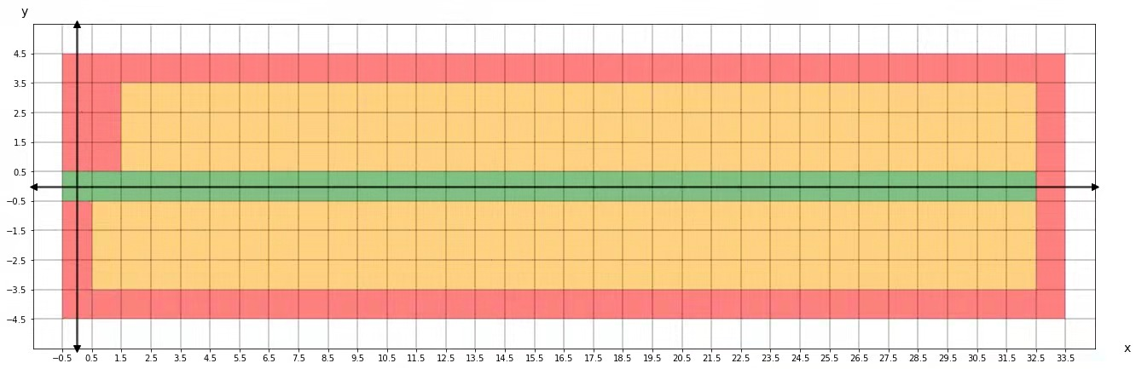
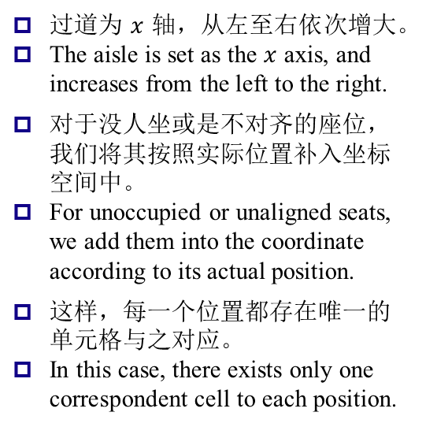

构建数学模型计算登机时间——常规状态 Devising a Model to Calculate Total Boarding Time – Under Regular States
这一部分中，我们将采用逐步推演的方式较为清晰地展示乘客速度之间的关系。
In this part, we’ll carefully deduct and explicitly display the connections between the passengers’ velocities.
坐标系的构建 - The construction of the coordinate
过道为$x$轴，从左至右依次增大。
The aisle is set as the $x$ axis, and increases from the left to the right.
对于没人坐或是不对齐的座位，我们将其按照实际位置补入坐标空间中。
For unoccupied or unaligned seats, we add them into the coordinate according to its actual position.
这样，每一个位置都存在唯一的单元格与之对应。
In this case, there exists only one correspondent cell to each position.
$$(4,1)$$
Cell 1
Cell 2
图 坐标系的构建
Fig. The construction of the coordinate
比如该墙体仍然被当作坐标格处理
For example, this wall is still taken as several cells.

Slide 2
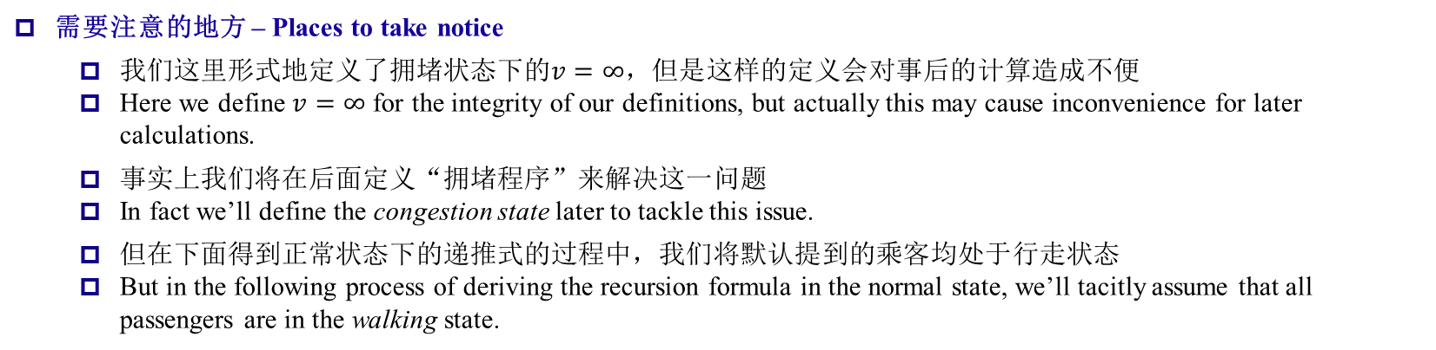
构建数学模型计算登机时间——常规状态 Devising a Model to Calculate Total Boarding Time – Under Regular States
构建数学模型计算登机时间——常规状态 Devising a Model to Calculate Total Boarding Time – Under Regular States
需要注意的地方 – Places to take notice
我们这里形式地定义了拥堵状态下的$v=∞，但是$这样的定义会对事后的计算造成不便
Here we define $v=∞$ for the integrity of our definitions, but actually this may cause inconvenience for later calculations.
事实上我们将在后面定义“拥堵程序”来解决这一问题
In fact we’ll define the congestion state later to tackle this issue.
但在下面得到正常状态下的递推式的过程中，我们将默认提到的乘客均处于行走状态
But in the following process of deriving the recursion formula in the normal state, we’ll tacitly assume that all passengers are in the walking state.

Slide 3
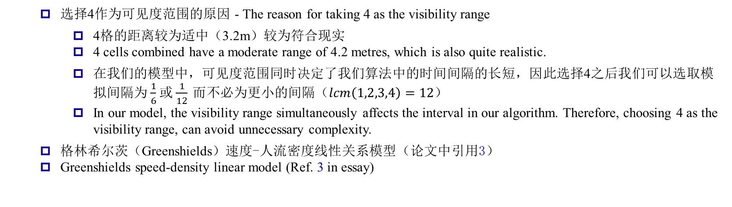
构建数学模型计算登机时间——常规状态 Devising a Model to Calculate Total Boarding Time – Under Regular States
根据人流密度计算乘客的速度 - Calculating passengers’ speed with the crowd density
在本模型中定义的人流密度 – The crowd density defined in our model
选择4作为可见度范围的原因 - The reason for taking 4 as the visibility range
4格的距离较为适中（3.2m）较为符合现实
4 cells combined have a moderate range of 4.2 metres, which is also quite realistic.
在我们的模型中，可见度范围同时决定了我们算法中的时间间隔的长短，因此选择4之后我们可以选取模拟间隔为$\frac{1}{6}$或$\frac{1}{12} 而$不必为更小的间隔（$lcm\left(1,2,3,4\right)=12$）
In our model, the visibility range simultaneously affects the interval in our algorithm. Therefore, choosing 4 as the visibility range, can avoid unnecessary complexity.
格林希尔茨（Greenshields）速度-人流密度线性关系模型（论文中引用3）
Greenshields speed-density linear model (Ref. 3 in essay)

Slide 4
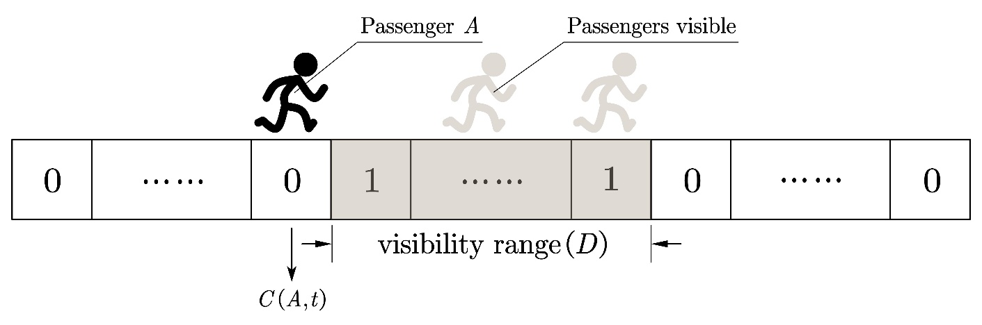
构建数学模型计算登机时间——常规状态 Devising a Model to Calculate Total Boarding Time – Under Regular States
根据乘客分布计算人流密度 – Calculating crowd density under a given passenger distribution
由两个分别代表乘客“能见度”与过道中乘客状态分布的向量数乘得到
Calculated through the dot product of two vectors which respectively represent the passenger’s visibility and the overall distribution in the aisle. (or the existence factor)
图 两个向量的直观表示
Fig. The intuitive illustration of the visibility and existence vectors
这样，我们得到了乘客能见度与乘客分布的线性积关系。
In this case, we’ve got the linear product relation between visibility and the overall crowd distribution.

Slide 5
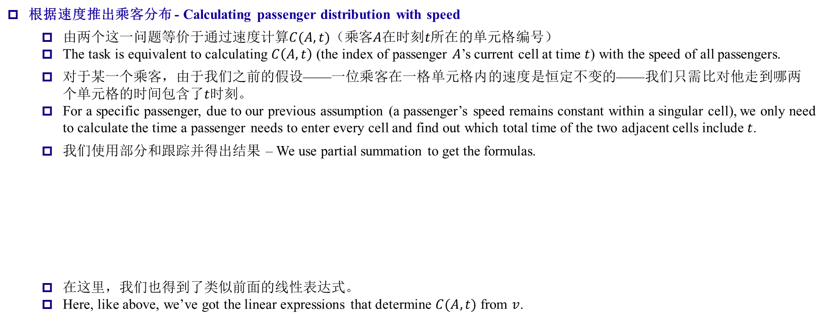
构建数学模型计算登机时间——常规状态 Devising a Model to Calculate Total Boarding Time – Under Regular States
根据速度推出乘客分布 - Calculating passenger distribution with speed
由两个这一问题等价于通过速度计算$C(A,t)$（乘客$A$在时刻$t所在$的单元格编号）
The task is equivalent to calculating $C\left(A,t\right)$ (the index of passenger $A$’s current cell at time $t$) with the speed of all passengers.
对于某一个乘客，由于我们之前的假设——一位乘客在一格单元格内的速度是恒定不变的——我们只需比对他走到哪两个单元格的时间包含了$t$时刻。
For a specific passenger, due to our previous assumption (a passenger’s speed remains constant within a singular cell), we only need to calculate the time a passenger needs to enter every cell and find out which total time of the two adjacent cells include $t$.
我们使用部分和跟踪并得出结果 – We use partial summation to get the formulas.
在这里，我们也得到了类似前面的线性表达式。
Here, like above, we’ve got the linear expressions that determine $C(A,t)$ from $v$.

Slide 6
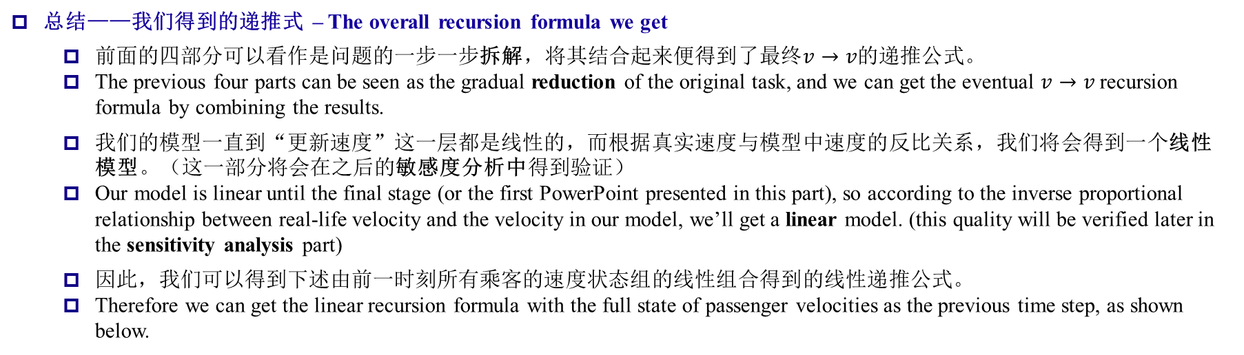
构建数学模型计算登机时间——常规状态 Devising a Model to Calculate Total Boarding Time – Under Regular States
总结——我们得到的递推式 – The overall recursion formula we get
前面的四部分可以看作是问题的一步一步拆解，将其结合起来便得到了最终$v→v$的递推公式。
The previous four parts can be seen as the gradual reduction of the original task, and we can get the eventual $v→v$ recursion formula by combining the results.
我们的模型一直到“更新速度”这一层都是线性的，而根据真实速度与模型中速度的反比关系，我们将会得到一个线性模型。（这一部分将会在之后的敏感度分析中得到验证）
Our model is linear until the final stage (or the first PowerPoint presented in this part), so according to the inverse proportional relationship between real-life velocity and the velocity in our model, we’ll get a linear model. (this quality will be verified later in the sensitivity analysis part)
因此，我们可以得到下述由前一时刻所有乘客的速度状态组的线性组合得到的线性递推公式。
Therefore we can get the linear recursion formula with the full state of passenger velocities as the previous time step, as shown below.

Slide 7
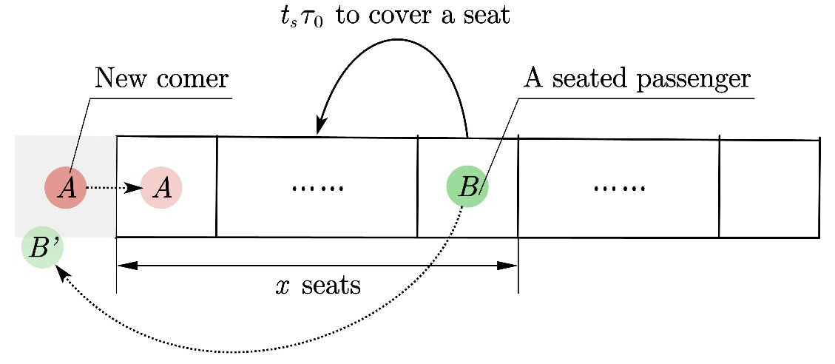
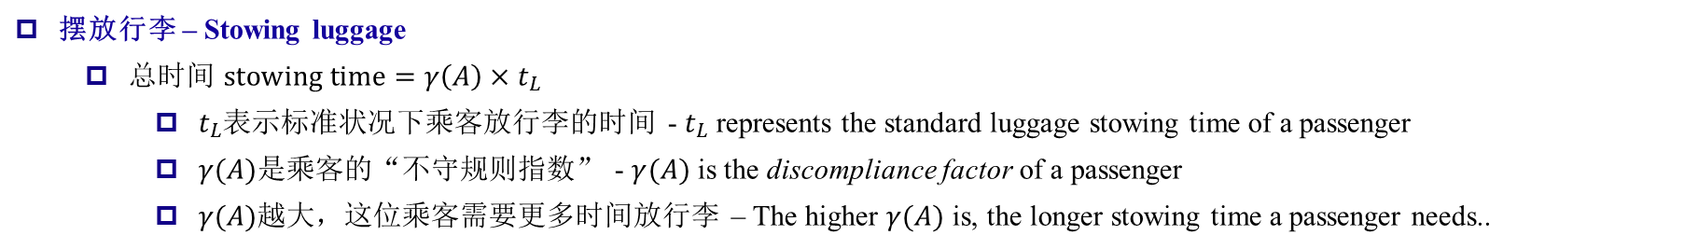
构建数学模型计算登机时间——拥挤状态 Devising a Model to Calculate Total Boarding Time – Under the Crowded States
解决遗留问题——拥挤状态的情形 – Tackling the remaining problems: the congestion state
状态的分析 – Analysis of different states
摆放行李 – Stowing luggage
总时间 $stowing time=γ\left(A\right)×t_{L}$
$t_{L}$表示标准状况下乘客放行李的时间 - $t_{L}$ represents the standard luggage stowing time of a passenger
$γ(A)$是乘客的“不守规则指数” - $γ(A)$ is the discompliance factor of a passenger
$γ(A)$越大，这位乘客需要更多时间放行李 – The higher $γ(A)$ is, the longer stowing time a passenger needs..
就坐与让座 - Getting seated and offering seats
乘客的让座时间正比于其座位距离过道的单元格数
The time that a passenger needs to offer his seat is proportional to the number of cells separating his seat and the aisle
取该行中最长时间为标准
We take the longest time to offer a seat among the row.
图 让座程序
Fig. Offering a seat

Slide 8
构建数学模型计算登机时间——拥挤状态 Devising a Model to Calculate Total Boarding Time – Under the Crowded States
解决遗留问题——拥挤状态的情形 – Tackling the remaining problems: the congestion state
状态的分析 – Analysis of different states
就坐 - Getting seated and offering seats
仔细看来，加入初始状态是确定的，那么让座时间便可以直接通过队列的顺序计算。
Under close inspection, if the original state is given, then the time to offer seats can be calculated.
对于某一行的乘客，由于不存在超到前面去的情况，到达这一行的乘客从前到后的顺序与他们一开始在队列中的顺序完全相同，因此可以据此事实直接计算。
For passengers in a specific row, since it’s not allowed to surpass anyone before them, the arrival sequence of this row’s passengers is the same as their original position in the queue. Therefore, we can calculate the total time of offering seats directly based on the given queue.

Slide 9
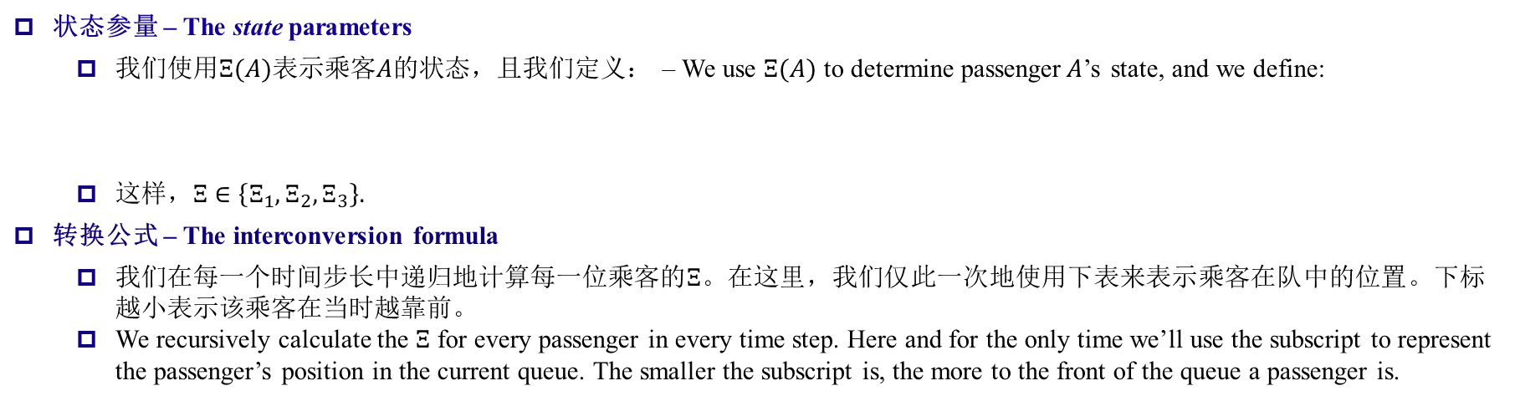
构建数学模型计算登机时间——拥挤状态 Devising a Model to Calculate Total Boarding Time – Under the Crowded States
解决遗留问题——拥挤状态的情形 – Tackling the remaining problems: the congestion state
状态的转换 – The interconversion of states
状态参量 – The state parameters
我们使用$Ξ(A)$表示乘客$A$的状态，且我们定义： – We use $Ξ(A)$ to determine passenger$A$’s state, and we define:
这样，$Ξ∈\left\{Ξ_{1}, Ξ_{2},Ξ_{3}\right\}.$
转换公式 – The interconversion formula
我们在每一个时间步长中递归地计算每一位乘客的$Ξ$。在这里，我们仅此一次地使用下表来表示乘客在队中的位置。下标越小表示该乘客在当时越靠前。
We recursively calculate the $Ξ$ for every passenger in every time step. Here and for the only time we’ll use the subscript to represent the passenger’s position in the current queue. The smaller the subscript is, the more to the front of the queue a passenger is.

